Slide 1


DS MINI PROJECT
BANKMATE
Team Details
Drishaan Prasad
Abhiram S Anilbabu
Sharon Stephen
(CSE 6A)

Slide 2
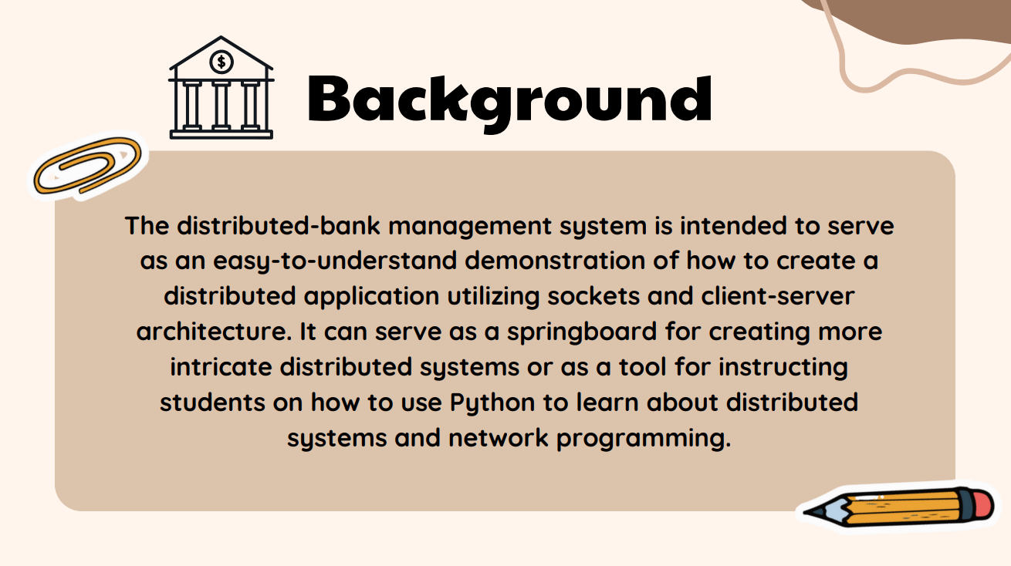

Slide 3
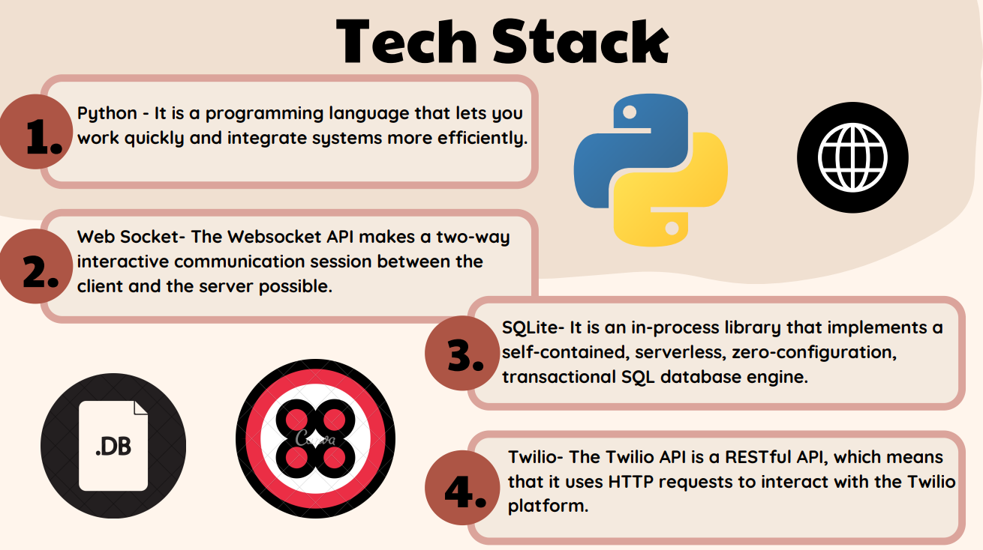

Slide 4
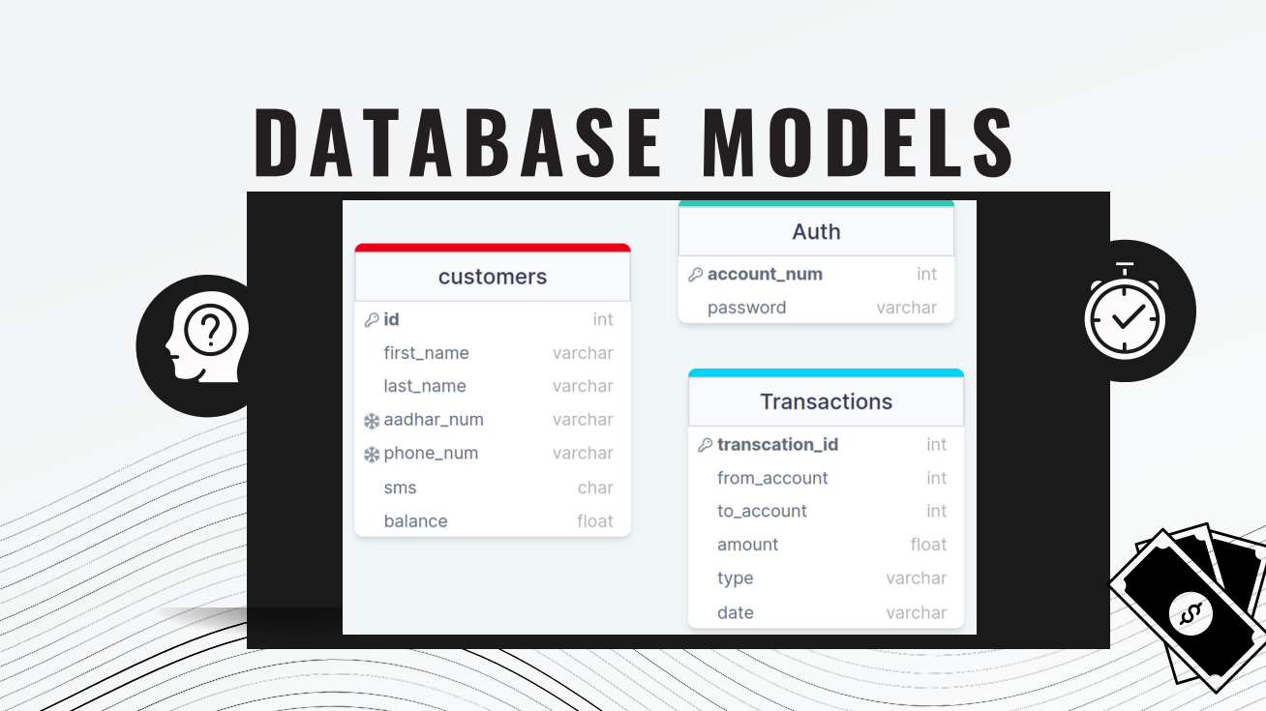

Slide 5
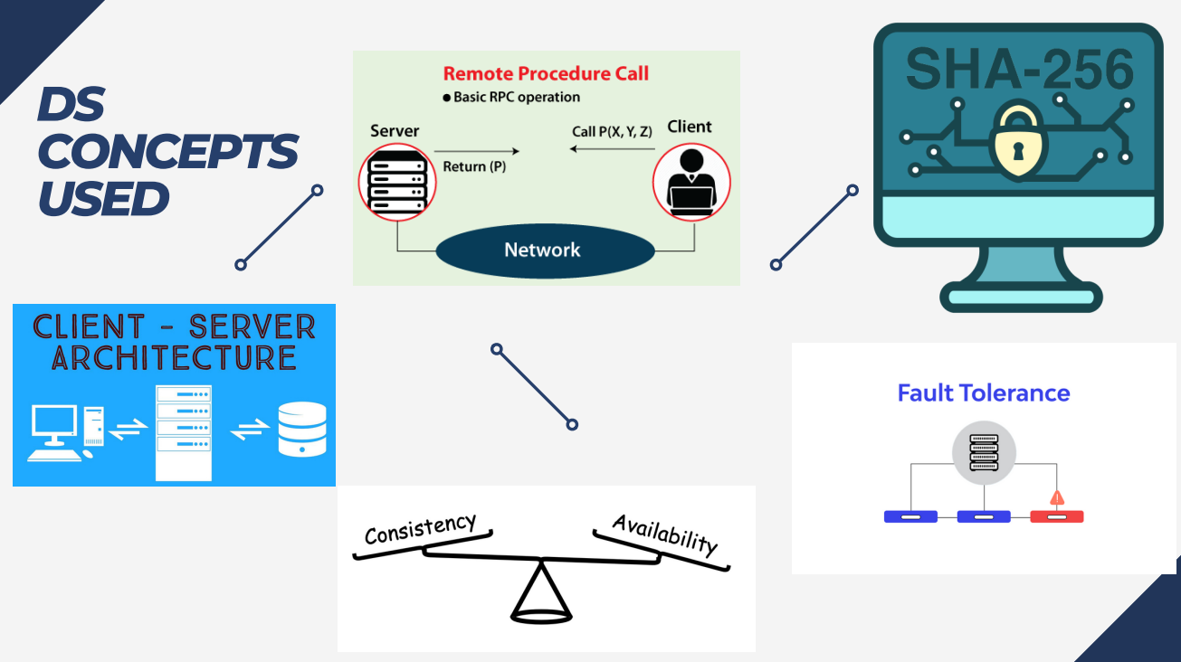

Slide 6


